Slide 1
Operating Systems (CSC 2205)
Instructor: Mr. Khwaja Bilal Hassan
BS CS UET Peshawar
M.Phil. CS Quaid-e-Azam University Islamabad
Lecture#12
Memory Management

Slide 2
Agenda for Today
What is memory management
Source code to execution
Address binding
Logical and physical address spaces
Dynamic loading, dynamic linking, and overlays

Slide 3
Memory Hierarchy
Very small, extremely fast, extremely expensive, and volatile CPU registers
Small, very fast, expensive, and volatile cache
Hundreds of megabytes of medium-speed, medium-price, volatile main memory
Hundreds of gigabytes of slow, cheap, and non-volatile secondary storage

Slide 4
Purpose of Memory Management
To ensure fair, secure, orderly, and efficient use of memory

Slide 5
Memory Management
Keeping track of used and free memory space
When, where, and how much memory to allocate and deallocate
Swapping processes in and out of main memory

Slide 6
Source to Execution
Compile/Assemble
↓
Link
↓
Load
↓
Execute

Slide 7
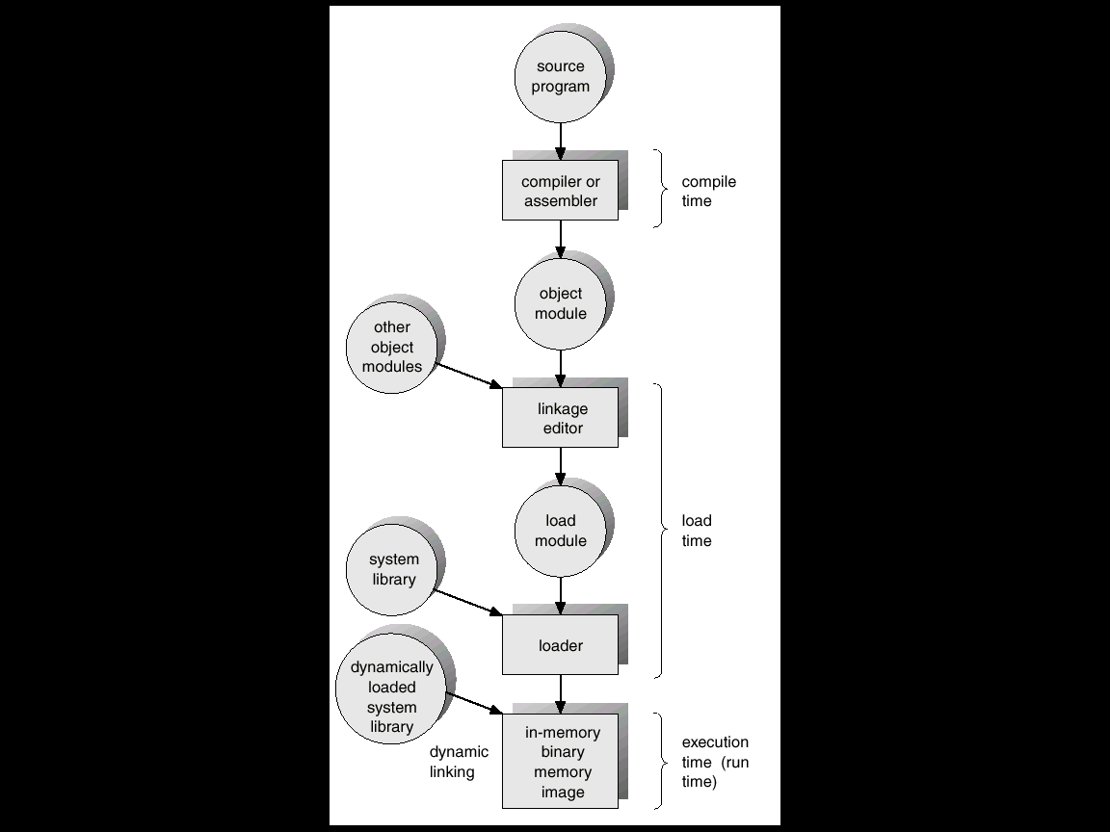

Slide 8
Address Binding
Binding instructions and data to memory addresses
Compile time
Load time
Execution time

Slide 9
Address Binding
Compile time: If you know at compile time where the process will reside in memory, the absolute code can be generated. Process must reside in the same memory region for it to execute correctly.

Slide 10
Address Binding
Load time: If the location of a process in memory is not known at compile time, then the compiler must generate re-locatable code. In this case the final binding is delayed until load time. Process can be loaded in different memory regions.

Slide 11
Address Binding
Execution time: If the process can be moved during its execution from one memory region to another, then binding must be delayed until run time. Special hardware must be available for this to work.

Slide 12
Logical and Physical Addresses
Logical address: An address generated by the process/CPU; refers to an instruction or data in the process
Physical address: An address for a main memory location where instruction or data resides

Slide 13
Logical and Physical Address Spaces
The set of all logical addresses generated by a process comprises its logical address space.
The set of physical addresses corresponding to these logical addresses comprises the physical address space for the process.

Slide 14
Logical and Physical Address Spaces
The run-time mapping from logical to physical addresses is done by a piece of the CPU hardware, called the memory management unit (MMU).

Slide 15
Example
The base register is called the relocation register.
The value in the relocation register is added to every address generated by a user process at the time it is sent to memory.

Slide 16
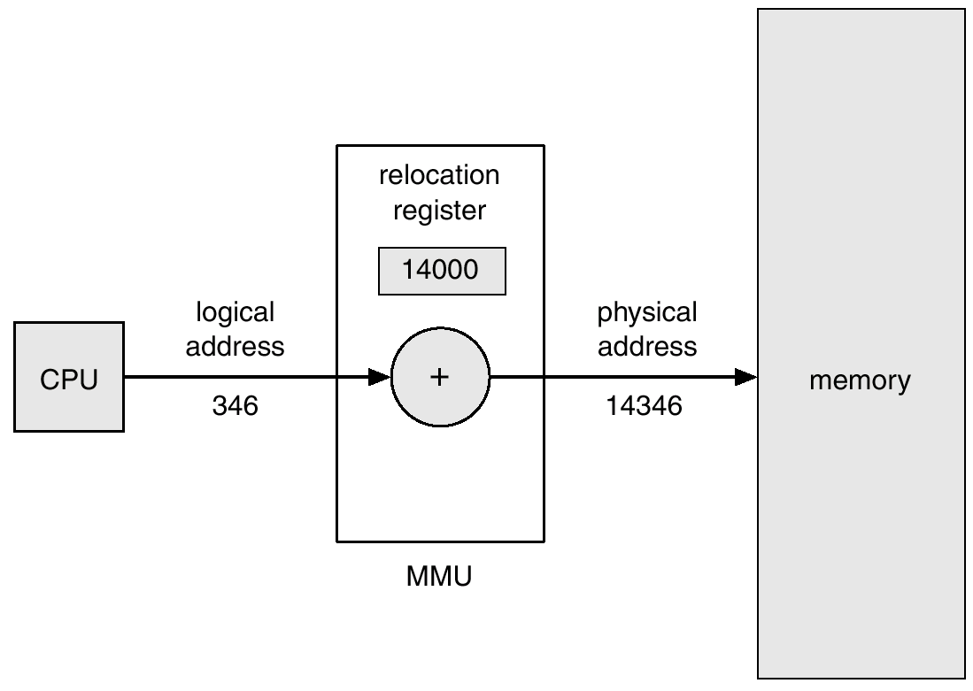
Example
₁₄₀₀₀
_{Process}

Slide 17
Dynamic Loading
With dynamic loading, a routine is not loaded into the main memory until it is called.
All routines are kept on the disk in a re-locatable format.
The main program is loaded into memory and is executed

Slide 18
Dynamic Loading
Advantages
Potentially less time needed to load a program
Potentially less memory space needed
Disadvantage
Run-time activity

Slide 19
Dynamic Linking
In static linking, system language libraries are linked at compile time and, like any other object module, are combined by the loader into the binary image

Slide 20
Dynamic Linking
In dynamic linking, linking is postponed until run-time.
A library call is replaced by a piece of code, called stub, which is used to locate memory-resident library routine

Slide 21
Dynamic Linking
During execution of a process, stub is replaced by the address of the relevant library code and the code is executed
If library code is not in memory, it is loaded at this time

Slide 22
Dynamic Linking
Advantages
Potentially less time needed to load a program
Potentially less memory space needed
Less disk space needed to store binaries

Slide 23
Dynamic Linking
Disadvantages
Time-consuming run-time activity, resulting in slower program execution
gcc compiler
Dynamic linking by default
-static option allows static linking

Slide 24
Overlays
Allow a process to be larger than the amount of memory allocated to it
Keep in memory only those instructions and data that are needed at any given time

Slide 25
Overlays
When other instructions are needed, they are loaded into the space occupied previously by instructions that are no longer needed
Implemented by user
Programming design of overlay structure is complex and not possible in all cases

Slide 26
Overlays Example
2-Pass assembler/compiler
Available main memory: 150k
Code size: 200k
Pass 1 ……………….. 70k
Pass 2 ……………….. 80k
Common routines …... 30k
Symbol table ………… 20k

Slide 27
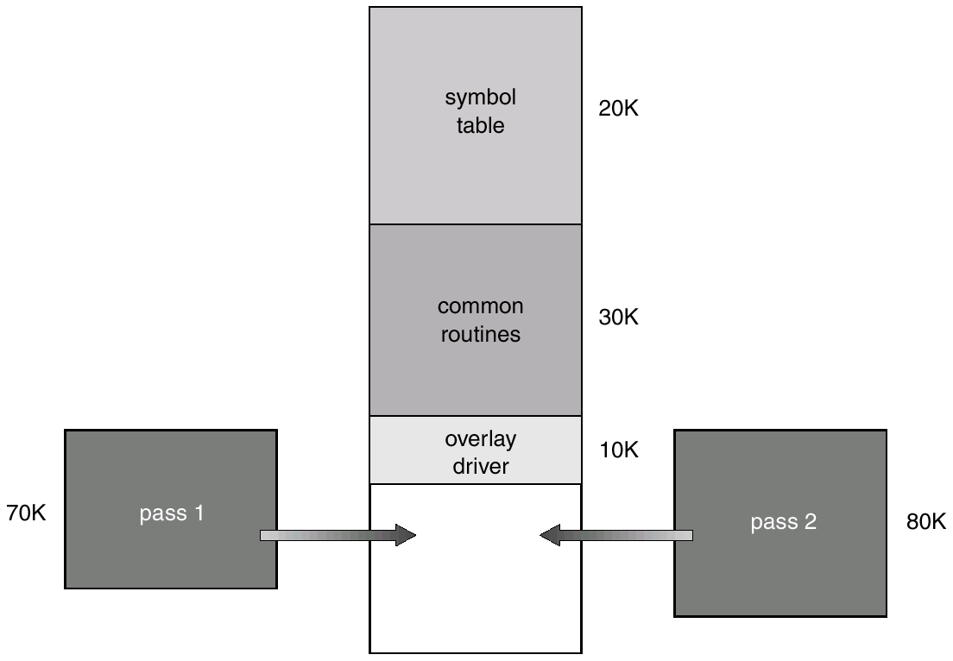
Overlays Example

Slide 28
Swapping
Swap out and swap in (or roll out and roll in)
Major part of swap time is transfer time; the total transfer time is directly proportional to the amount of memory swapped
Large context switch time

Slide 29
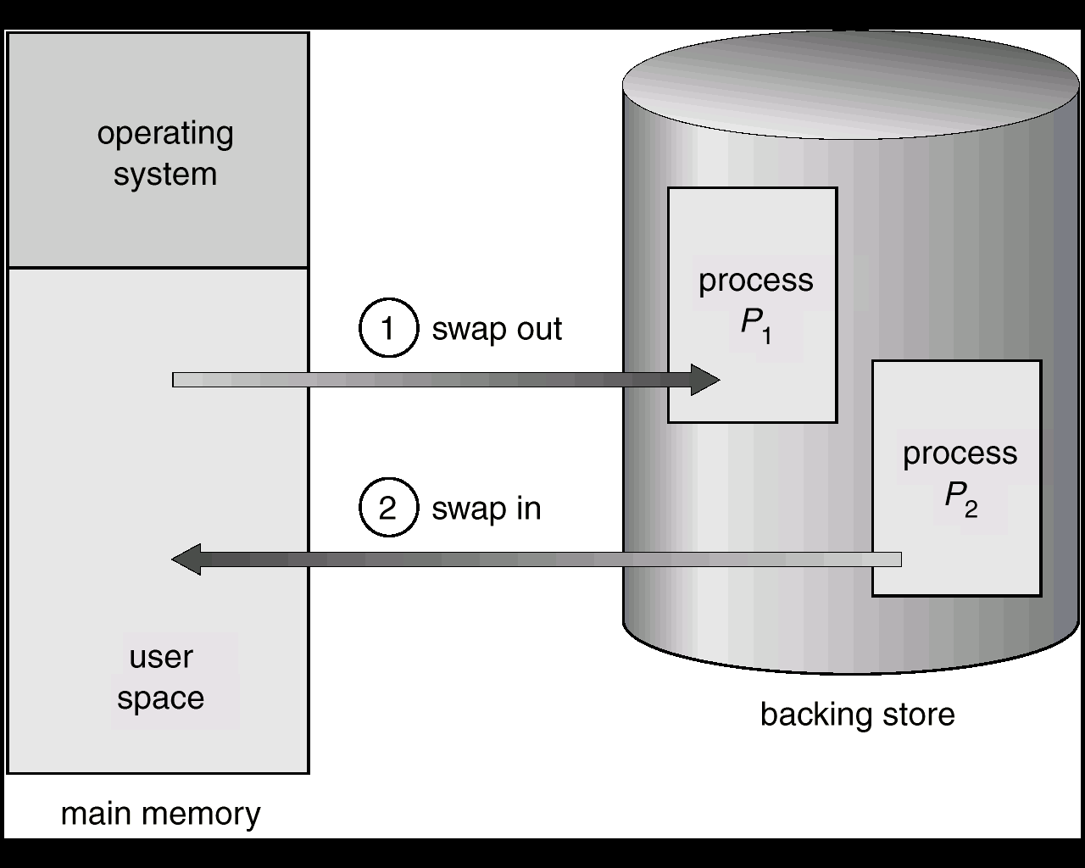
Swapping

Slide 30
Cost of Swapping
Process size = 1 MB
Transfer rate = 5 MB/sec
Swap out time = 1/5 sec = 200 ms
Average latency = 8 ms
Net swap out time = 208 ms
Swap out + swap in = 416 ms

Slide 31
Issues with Swapping
Quantum for RR scheduler
Pending I/O for swapped out process
User space used for I/O
Solutions
Don’t swap out processes with pending I/O
Do I/O using kernel space

Slide 32
Contiguous Allocation
Kernel space, user space
A process is placed in a single contiguous area in memory
Base (re-location) and limit registers are used to point to the smallest memory address of a process and its size, respectively.

Slide 33
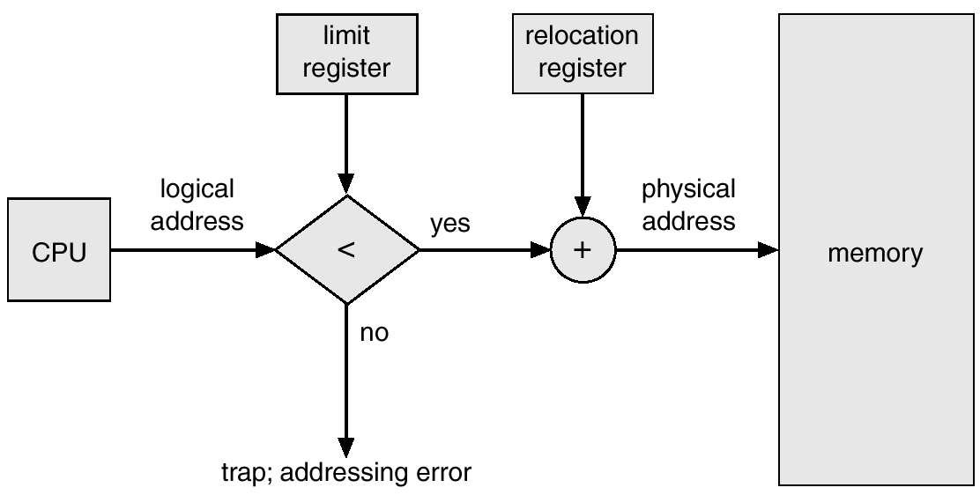
Contiguous Allocation
Process
Main Memory

Slide 34
MFT
Multiprogramming with fixed tasks (MFT)
Memory is divided into several fixed-size partitions.
Each partition may contain exactly one process/task.

Slide 35
MFT
Boundaries for partitions are set at boot time and are not movable.
An input queue per partition
The degree of multiprogramming is bound by the number of partitions.

Slide 36
MFT
Partition 4
Partition 3
Partition 2
Partition 1
OS
100 K
300 K
Input Queues
200 K
150 K

Slide 37
MFT With Multiple Input Queues
Potential for wasted memory space—an empty partition but no process in the associated queue
Load-time address binding

Slide 38
MFT With Single Input Queue
Single queue for all partitions
Search the queue for a process when a partition becomes empty
First-fit, best-fit, worst-fit space allocation algorithms

Slide 39
MFT With Single Input Queue
Partition 4
Partition 3
Partition 2
Partition 1
OS
100 K
300 K
Input Queue
200 K
150 K

Slide 40
Example: First fit
Processes
Partitions
Process ID | Memory Size
1 | 200
2 | 150
3 | 300
Starting Address | Size
0 | 500
500 | 300
800 | 200
1000 | 100
1100 | 400
Allocation
Process ID | Memory Size | Allocated Partition
1 | 200 | 0
2 | 150 | 500
3 | 300 | 1100

Slide 41
Example: Best fit
Processes
Partitions
Process ID | Memory Size
1 | 200
2 | 150
3 | 300
Starting Address | Size
0 | 500
500 | 300
800 | 200
1000 | 100
1100 | 400
Allocation
Process ID | Memory Size | Allocated Partition
1 | 200 | 800
2 | 150 | 500
3 | 300 | 1100

Slide 42
Example: Worst Fit
Processes
Partitions
Process ID | Memory Size
1 | 200
2 | 150
3 | 300
Starting Address | Size
0 | 500
500 | 300
800 | 200
1000 | 100
1100 | 400
Allocation
Process ID | Memory Size | Allocated Partition
1 | 200 | 800
2 | 150 | 0
3 | 300 | 500

Slide 43
MFT Issues
Internal fragmentation—wasted space inside a fixed-size memory region
No sharing between processes.
Load-time address binding with multiple input queues

Slide 44
MVT
Multiprogramming with variable tasks (MFT)
Both the number and size of partitions change with time
A process still resides in one region but can be of any size up to the size of the user space and can change with time.

Slide 45
MVT
Jobs can move from one partition to another
Dynamic address binding
No internal fragmentation
Introduces external fragmentation

Slide 46
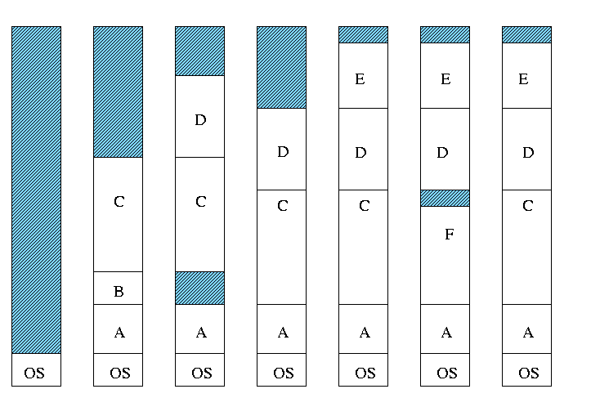
MVT
50K
200K

Slide 47
External Fragmentation
External Fragmentation refers to the state of memory space when total amount of unused memory space exists to satisfy a request but this memory space is not contiguous.

Slide 48
External Fragmentation
Compact main memory (shuffle processes around to put free space in one contiguous area)
Slows down execution of currently running processes

Slide 49
Paging
Divide physical memory into fixed-sized blocks, called frames
Divide logical memory into blocks of the same size, called pages
Size of a page is a power of 2
Typical page sizes: 1K – 16K
Notes:
using a power of 2 page size simplifies address translation, reduces hardware complexity, improves memory allocation efficiency, and provides a balance between granularity and efficiency. These factors contribute to the overall performance and efficiency of memory management in modern operating system

Slide 50
Paging
Keep track of all free frames.
To run a program of size n pages, find n free frames and load program pages into these frames.
Keep track of a program’s pages in the main memory by using the page table.

Slide 51
Paging
0
1
2
…
9
10
…
15
0
1
2
3
4
5
6
7
Process Address Space
Physical Address Space

Slide 52
Paging
0
1
2
…
9
10
…
15
0
1
2
3
4
5
6
7
Page
0
1
2
3
…
7
3
9
11
…
1
Page Table
Process Address Space
Physical Address Space

Slide 53
Paging
0
1
2
…
9
10
…
15
0
1
2
3
4
5
6
7
0
1
2
3
…
7
9
…
Page Table
Process Address Space
Physical Address Space

Slide 54
Paging
Logical address space of a process can be noncontiguous; a process page is allocated a frame whenever the latter is available.
Set up a page table to translate logical addresses to physical addresses.
Internal fragmentation

Slide 55
Addressing in Paging
Logical address: (p, d)
where, p is page number and d is offset within the page
p is used to index the process page table; page table entry contains the frame number, f, where page p is loaded

Slide 56
Addressing in Paging
Physical address of the location referenced by (p,d) is computed by appending d at the end of f, as shown below:
f | d

Slide 57
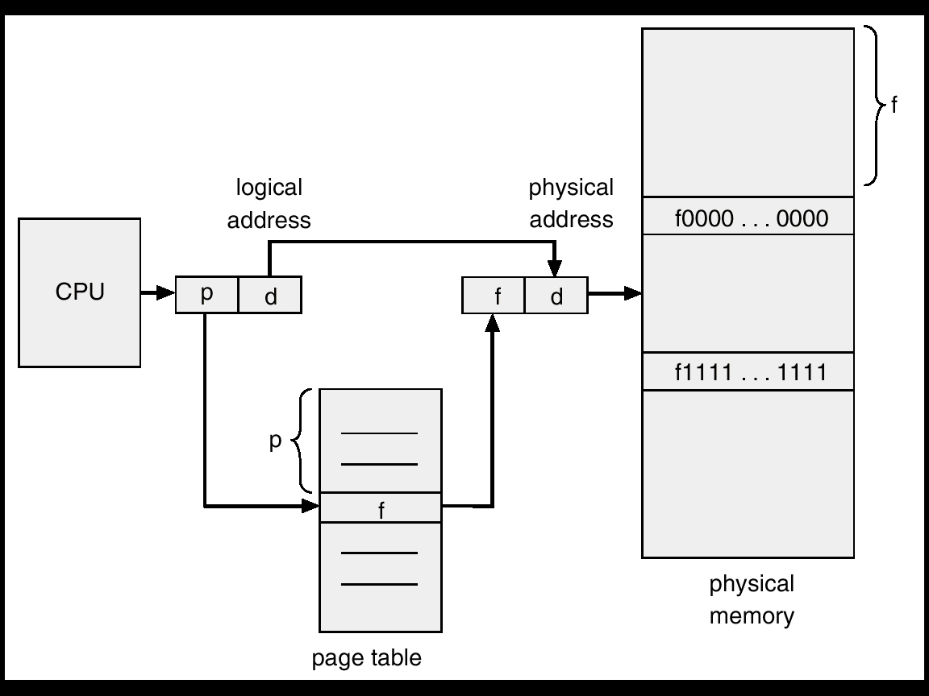
Address Translation
f

Slide 58
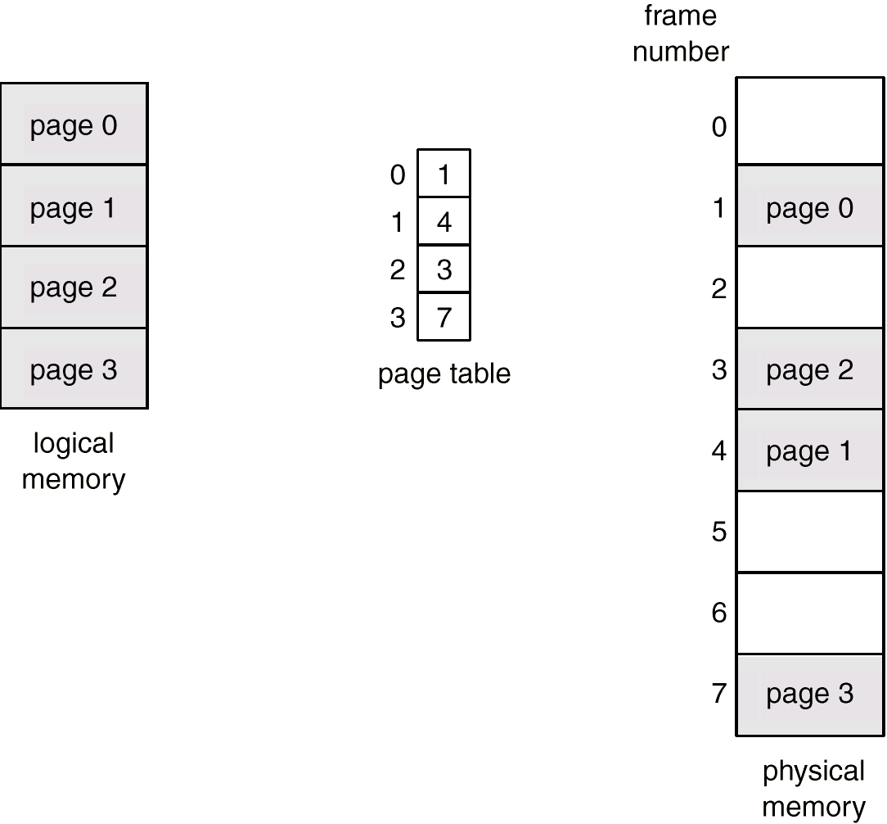
Addressing Example

Slide 59
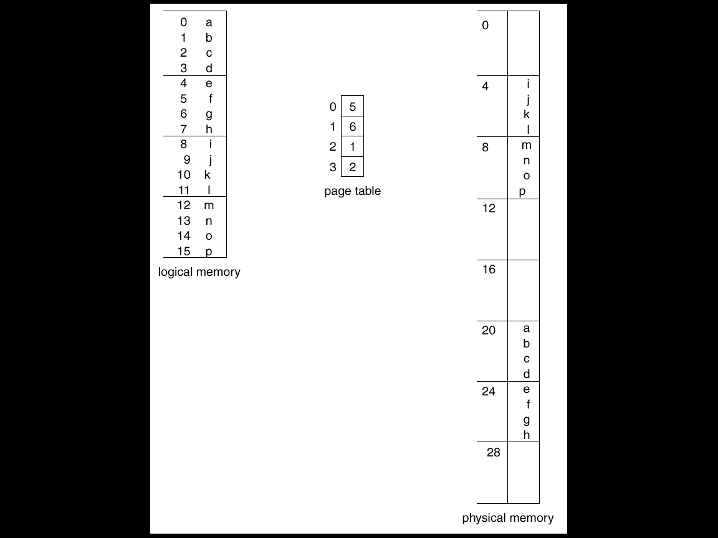
Paging Example
Page size = 4 bytes
Process address space = 4 pages
Physical address space = 8 frames
Logical address: (1,3)
= 0111
Physical address: (6,3)
= 11011
0
Page
Frame
1
0111
2
3
11011

Slide 60
Addressing in Paging
Logical address space of 16 pages of 1024 words each, mapped into a physical memory of 32 frames.
Logical address size?
Physical address size?
Number of bits for p, f, and d?

Slide 61
Addressing in Paging
No. of bits for p = ceiling [log2 16] bits
= 4 bits
No. of bits for f = ceiling [log2 32] bits
= 5 bits
No. of bits for d = ceiling [log2 2048] bits
= 11 bits

Slide 62
Addressing in Paging
Logical address size = |p| + |d|
= 4+11
= 15 bits
Physical address size = |f| + |d|
= 5+11
= 16 bits

Slide 63
Page Table Size
Page table size = NP * PTES
where NP is the number of pages in the process address space and PTES is the page table entry size (equal to |f| based on our discussion so far).
Page table size = 16 * 5 bits
= 16 bytes

Slide 64
Implementation of Page Table
In CPU registers
OK for small process address spaces and large page sizes
Effective memory access time (Teffective) is about the same as memory access time (Tmem)
PDP-11

Slide 65
Implementation of Page Table
Keep page table in the main memory
Page table base register (PTBR)
Teffective = 2Tmem
Teffective is not acceptable

Slide 66
Implementation of Page Table
Use a special, small, fast lookup hardware, called translation look-aside buffer (TLB)
Typically 64–1024 entries
An entry is (key, value)
Parallel search for key; on a hit, value is returned

Slide 67
Implementation of Page Table
(key,value) is (p,f) for paging
For a logical address, (p,d), TLB is searched for p. If an entry with a key p is found, we have a hit and f is used to form the physical address. Else, page table in the main memory is searched.

Slide 68
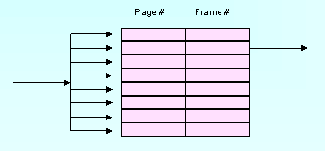
TLB
Logical address: (p, d)
f
p

Slide 69
Implementation of Page Table
The TLB is loaded with the (p,f) pair so that future references to p are found in the TLB, resulting in improved hit ratio.
On a context switch, the TLB is flushed and is loaded with values for the scheduled process.

Slide 70
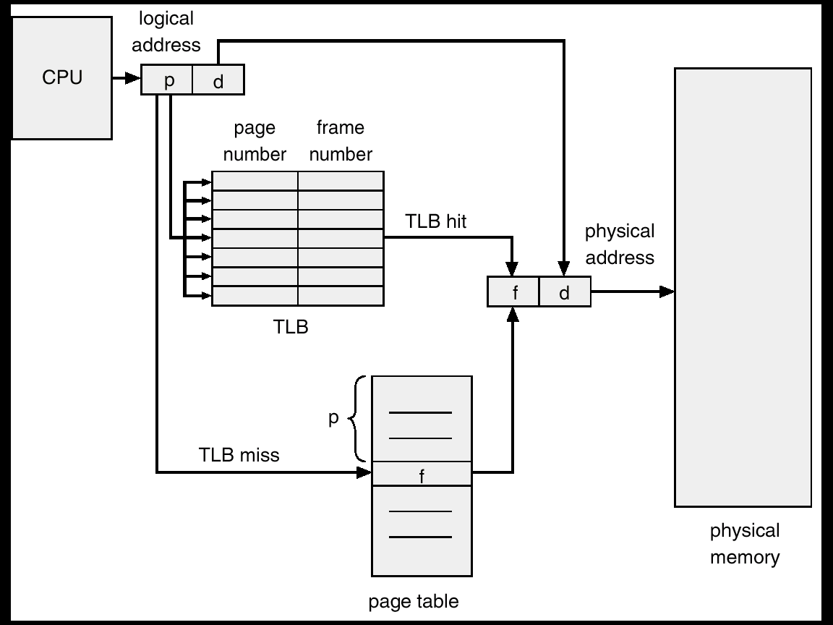
Paging Hardware

Slide 71
Performance of Paging
Teffective on a hit = Tmem + TTLB
Teffective on a miss = 2Tmem + TTLB
If HR is hit ratio and MR is miss ratio, then
Teffective = HR (TTLB + Tmem)
+ MR (TTLB + 2Tmem)

Slide 72
Example
Tmem = 100 nsec
TTLB = 20 nsec
Hit ratio is 80%
Teffective = ?
Teffective = 0.8 (20 + 100)
+ 0.2 (20 + 2x100)
= 140 nanoseconds

Slide 73
Example
Tmem = 100 nsec
TTLB = 20 nsec
Hit ratio is 98%
Teffective = ?
Teffective = 0.98 (20 + 100)
+ 0.02 (20 + 2x100)
= 122 nanoseconds

Slide 74
Segmentation
A memory management scheme that supports programmer’s view of memory.
A segment is a logical unit such as: main program, procedure, function, method, object, global variables, stack, symbol table
A program is a collection of segments

Slide 75
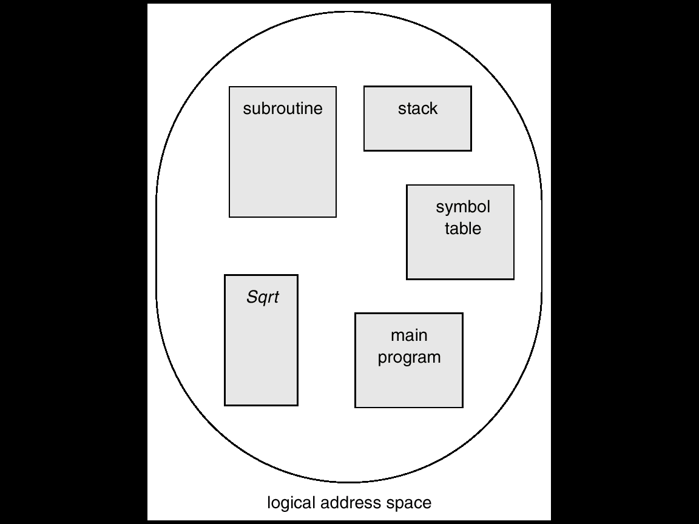
Segmentation

Slide 76
Segmentation
1
2
3
4
5
logical memory
physical memory

Slide 77
Segmentation
1
1
1
4
4
2
5
3
4
2
2
3
5
3
logical memory
physical memory

Slide 78
Segmentation
1
1
4
4
1
2
5
3
4
2
2
3
segment table
3
5
logical memory
physical memory

Slide 79
Segmentation
Logical address consists of a two tuple:
<segment-number, offset>
Segment table – maps two-dimensional logical addresses to physical addresses

Slide 80
Segmentation
Each segment table entry has:
base – contains the starting physical address where the segments reside in memory.
limit – specifies the length of the segment.

Slide 81
Segmentation
Segment-table base register (STBR) points to the segment table’s location in memory.
Segment-table length register (STLR) indicates number of segments used by a program
Segment number s is legal if s < STLR

Slide 82
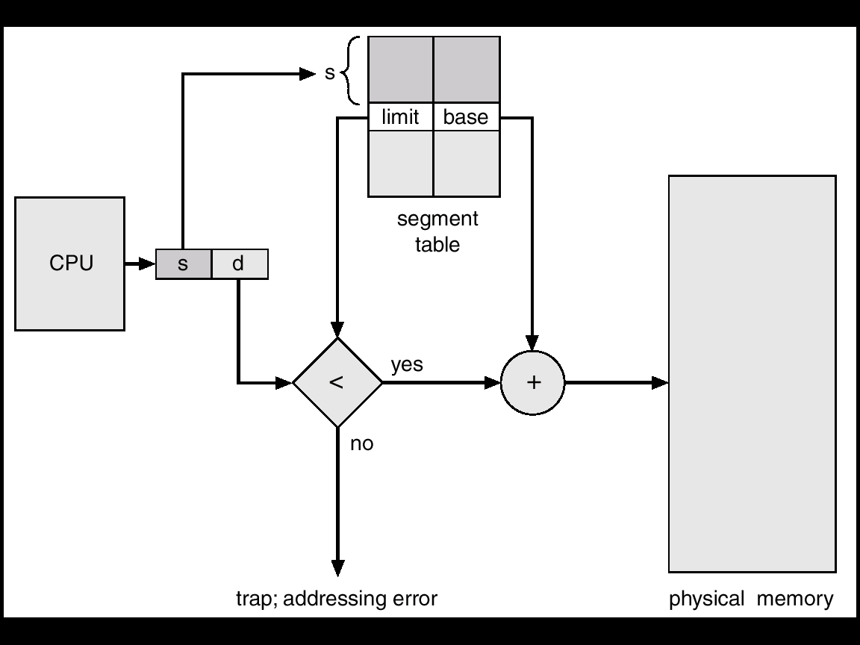
Segmentation
CPU

Slide 83
Segmentation Architecture
Relocation
Dynamic
By segment table
Sharing
Shared segments
Same segment number

Slide 84
Segmentation Architecture
Dynamic Storage Allocation
First fit
Best fit
Worst fit
External fragmentation

Slide 85
Segmentation Architecture
Protection: Bits are associated for this purpose with each entry in segment table:
Validation bit = 0 ⇒ illegal segment
Read, write, execute bits

Slide 86
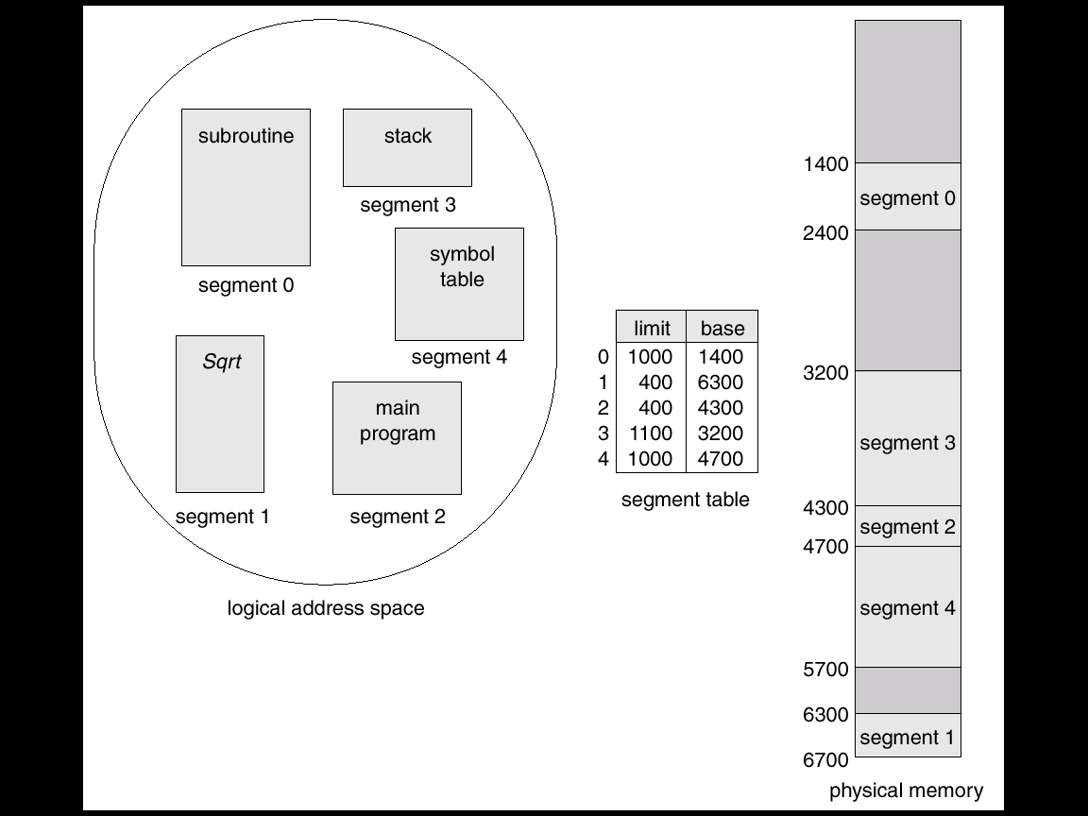
Example

Slide 87
Address Translation
Logical and Physical Addresses
(2, 399) – PA: 4300+399 = 4699
(4, 0) – PA: 4700+0 = 4700
(4, 1000) ⇒ trap
(3, 1300) ⇒ trap
(6, 297) ⇒ trap

Slide 88
Sharing of Segments
Sharing at the segment level and not at the fixed-size page level
Sharing at the code or data level
Segment table of multiple processes point to the same segment

Slide 89
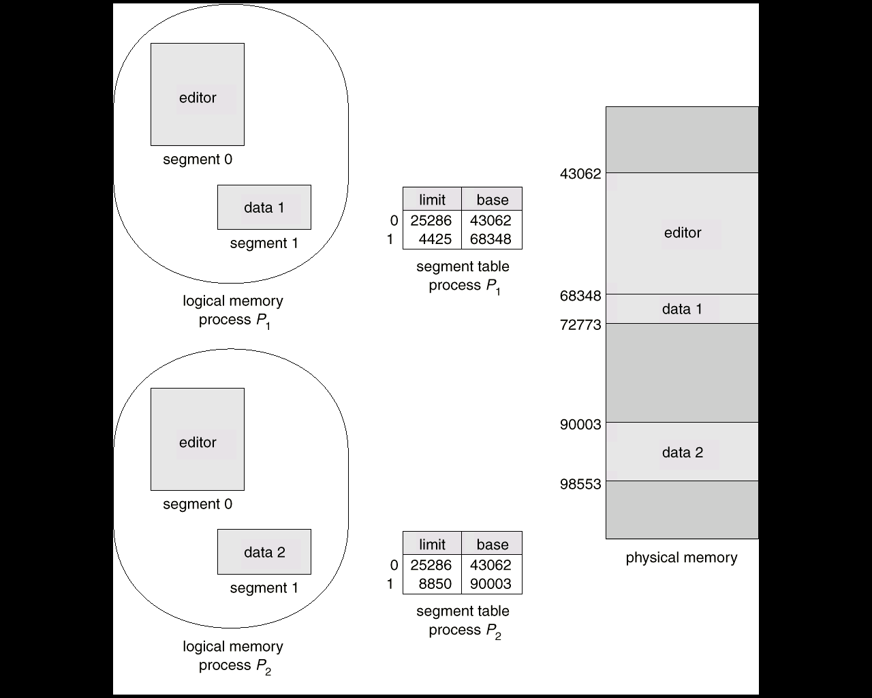
Sharing of Segments

Slide 90
Issues with Segmentation
External Fragmentation
Total memory space exists to satisfy a space allocation request for a segment, but memory space is not contiguous.

Slide 91
Issues with Segmentation
Reduce external fragmentation by compaction
Shuffle segments to place free memory together in one block.
Compaction is possible only if relocation is dynamic, and is done at execution time.

Slide 92
Issues with Segmentation
I/O problem
Latch job in memory while it is involved in I/O.
Do I/O only into OS buffers
Very large segments ⇒ page program segments—paged segmentation

